Slide 1
about:other projects
Conference/event name
Location
name
openSUSE Ambassador
name@opensuse.org

Slide 2
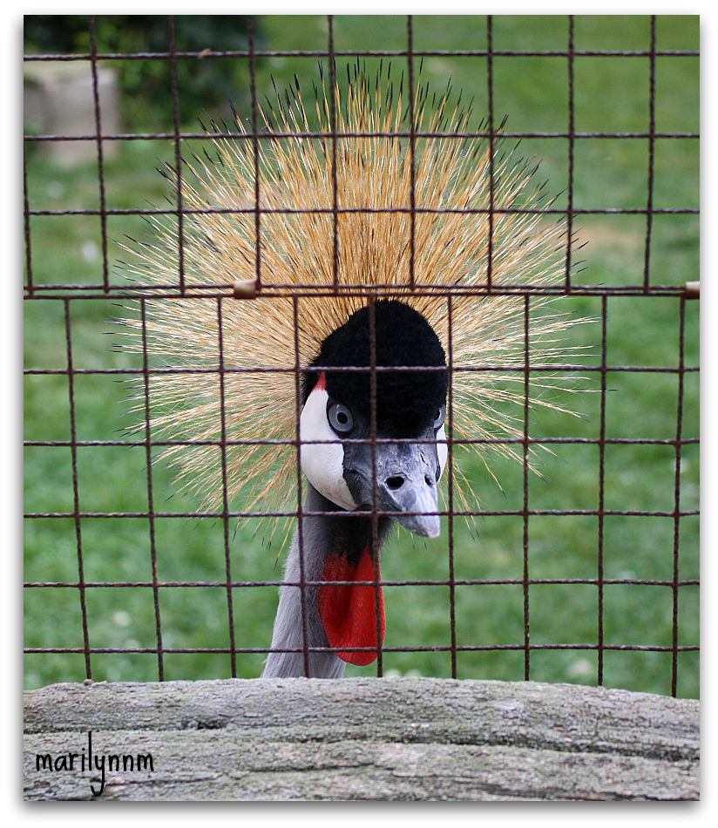
Me
Notes:
about yourself!

Slide 3
Tumbleweed
openQA
OpenSUSE ARM
Notes:
We will talk about 3 different openSUSE (based) projects besides the openSUSE distribution, SUSE Studio and the Open Build Service:
openSUSE Tumbleweed
OpenQA
openSUSE ARM

Slide 4
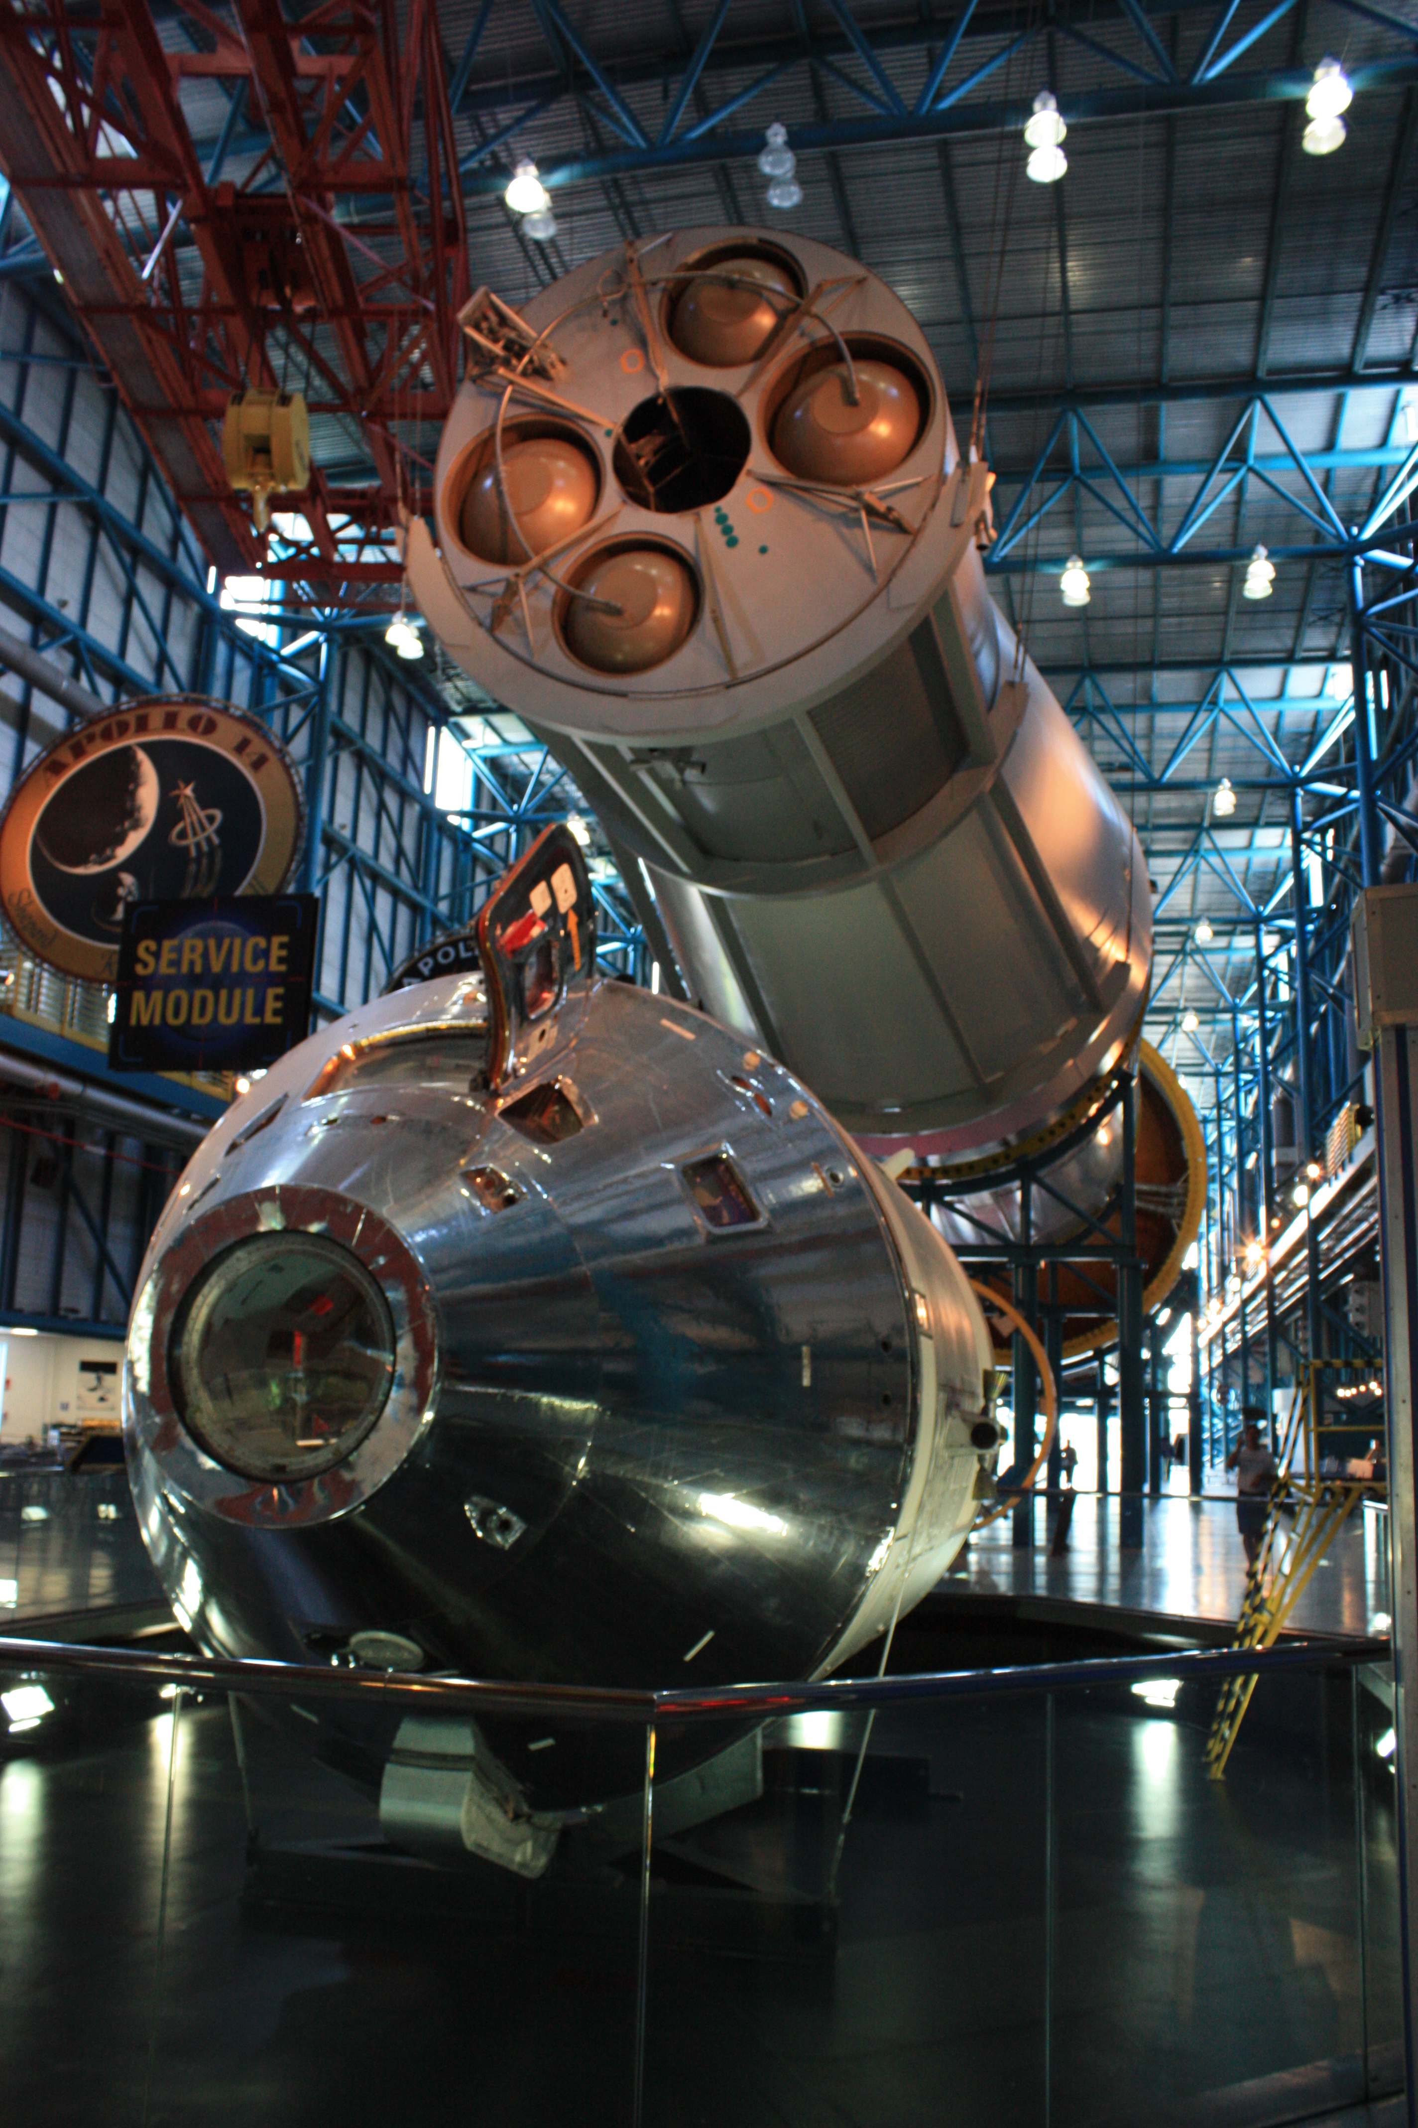
Building complicated things
Notes:
For the lazy among us: how to click together a completely customized linux distribution in 5 minutes!

Slide 5

Tumbleweed
Notes:
Next openSUSE project: Tumbleweed

Slide 6
Rolling on
Always the latest stable software
  Latest kernel = latest hardware support
  Latest browser, office, desktop, games...
Smoothly 'rolling' to the next release of openSUSE
No more 'download and install the new release'!
No more adding special repositories for newer software
Slightly more risk of breakage (price of living on the edge!)
Notes:
A roling release means that if newer software is released you will get it with an update after a short testing period
We developed Tumbleweed because we noticed that many openSUSE users had a large number of extra repositories (often 20 or more!) with newer versions of their software. While OBS is quite good, this can get messy if you mix incompatible repositories. Tumbleweed is much better as it is one repository.

Slide 7
How?
Open Build Service
  Just submit...
opensuse.org/Tumbleweed
Notes:
Having both a stable release and a rolling one would be almost impossible without OBS.
Tumbleweed is just another repository on the Build Service. Package maintainers can easily get their packages in Tumbleweed via OBS.
For users, it is simple to. Just add the repository, disable the others and do a zypper dup.
Go to opensuse.org/Tumbleweed for fun!

Slide 8
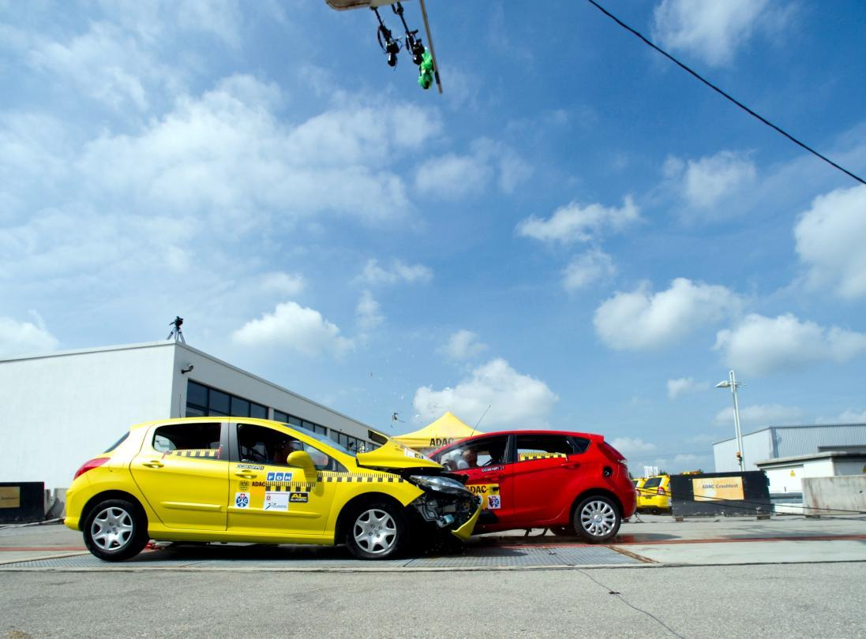
openQA
Notes:
The next project I want to talk about is openQA

Slide 9

Fully automated testing
Covers:
  Installation and upgrade testing
  Daily regression testing
  Application testing
  benchmarking
Gives clear overview of test results along with screenshots and video
Notes:
openQA is a automated testing system which runs daily tests on the openSUSE development tree 'Factory'.

Slide 10
How?
Boot ISO in VM (KVM or Qemu)
Give pre-defined input (mouse, keyboard)
Take screenshots of process
Compare screenshots with reference
Show results in web interface
Notes:
It works by booting up a ISO image (which is automatically generated daily from the Open Build Service) in a Virtual Machine. It installs it, boots, starts some applications and does a few simple actions. It takes screenshots during that process. It will then compare the screenshots it got with what was expected and thus know the test results.

Slide 11
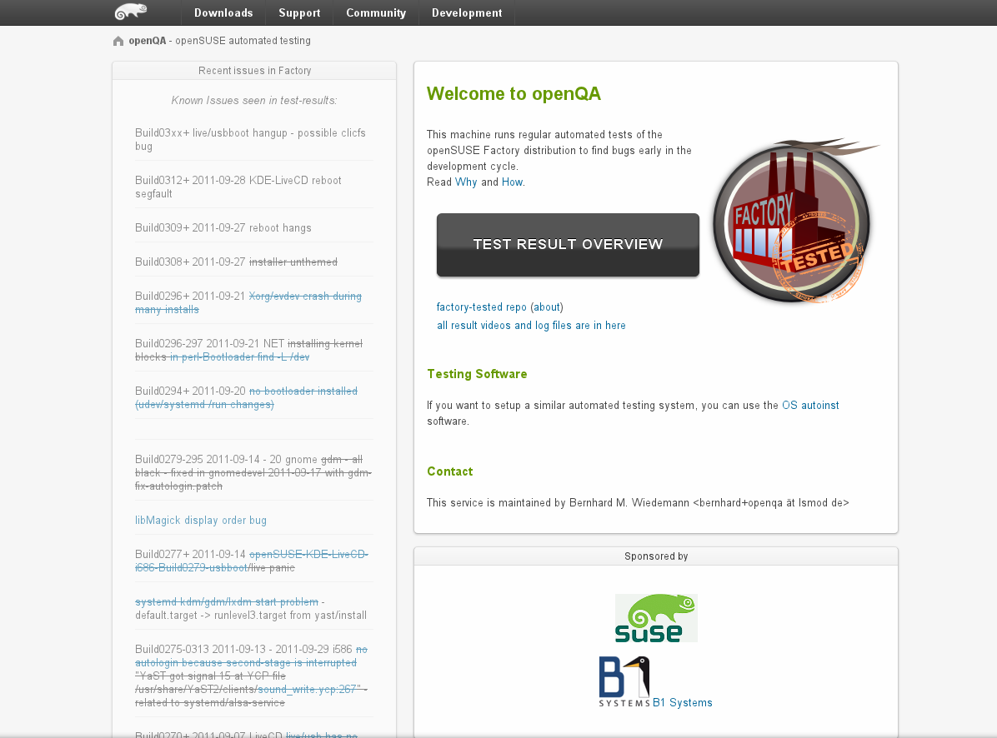
Notes:
This is the main interface of openqa.opensuse.org where you can check the test results.

Slide 12
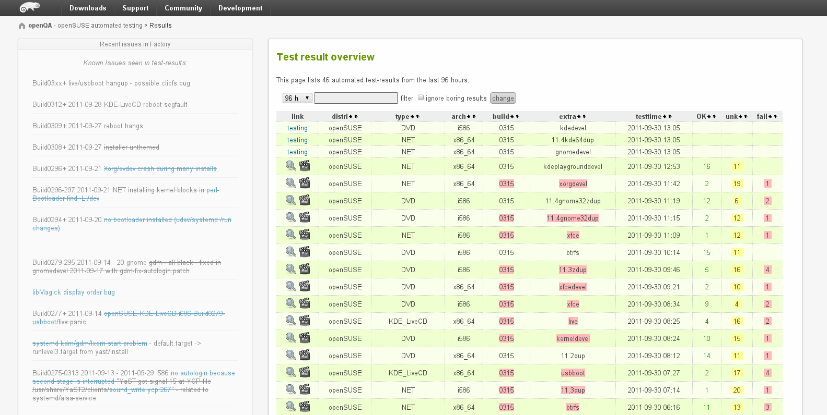
Notes:
Here is a list of tests which has run and the results.

Slide 13
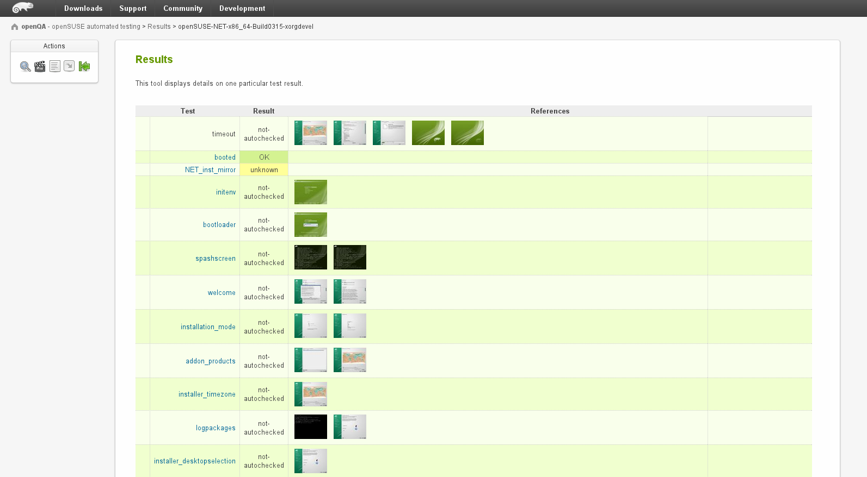
Notes:
You can see the details of a test, and as you can see you can download and inspect the screenshots.

Slide 14
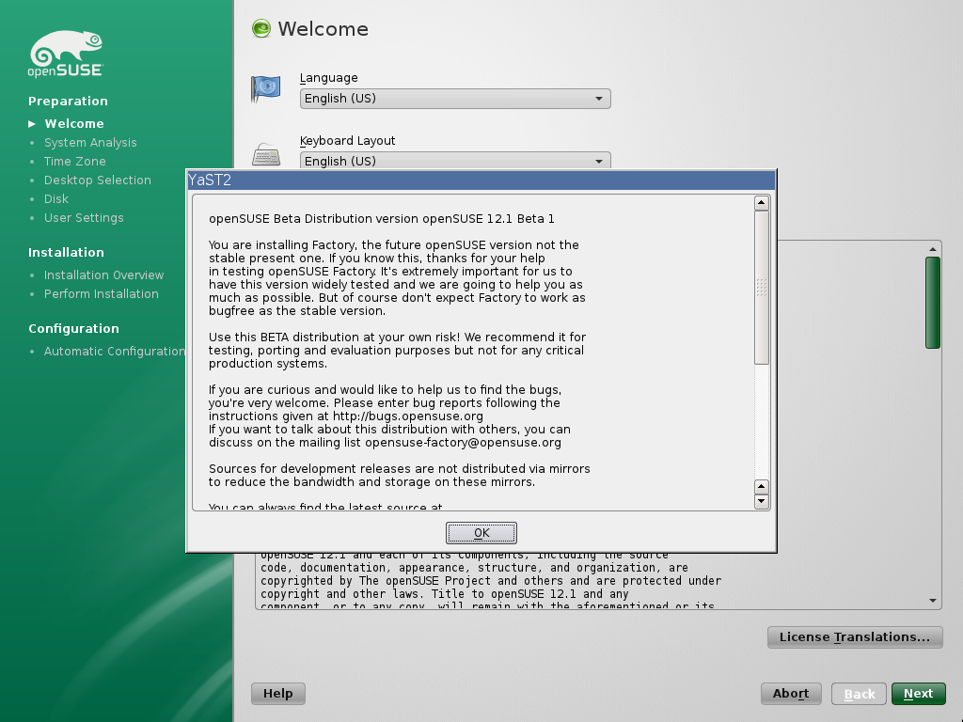
Notes:
Besides the screenshots openQA also offers video's of the whole process for download.

Slide 15

OpenSUSE ARM
Goal: get openSUSE on ARM!
  Started by a few community members after oSC 2011
  Took off right away
Notes:
openSUSE ARM is a real grass-roots project in the openSUSE community. It was started after the openSUSE Conference in October 2011.
As SUSE is pretty much entirely focused on big iron hardware like stock exchanges, they are not interested. Still SUSE supports us by providing infrastructure and admin support.

Slide 16
Status
Most of the openSUSE packages build and work
Boots and runs fine on beagle board!
Supported:
  armv5tel
  armv7l
Notes:
We currently focus on the most used ARM architectures: armv5tel (soft floating point with thumbs) and armv7l (hard floating point with aapcs-linux ABI)
Thanks to OBS it took us barely 2 weeks to get 2500 packages building and supporting other architectures should not be to hard. Get involved if you want openSUSE on your tablet or other ARM devices!

Slide 17

SuperKitty!
Notes:
By now everyone has to be convinced. openSUSE = super Kitty!
Awesome technology
Great plans

Slide 18

Newcomers welcome
Notes:
Which is always looking for new volunteers
people who actually want to make a difference!

Slide 19

opensuse.org
planet.opensuse.org
opensuse.org/Portal:How_to_participate
opensuse.org/Junior_jobs
features.opensuse.org
build.opensuse.org
openhatch.org
#opensuse-project

Slide 20

Join the gang
Notes:
... come join us and have fun...
Try openSUSE, Tumbleweed, SUSE Studio, TRY OBS, play with us!

Slide 21

Be a Geeko/Kitten
Notes:
Be the Geeko you can be!

Slide 22
Kitty Image credits
Me: Merlijn Hoek
You: artolog
openSUSE: clevergrrl
Novell: sensual shadows
Business: marissa cap
Strategy: dabogirl
Others: pasotraspaso
We are nice: cseeman
Beware: ian
SuperKitty: malingering
Cuddly: andreas solberg
Newcomers: abcrumly
Join the gang: malingering
GeekoKitten: no idea
To be found on Flickr under the above names with a Creative Commons license. Thanks all!

Slide 23
Your next Linux Distribution!

